Slide 1

Investigation of serial data communication in Multi FPGA network of chips
M. Tech. Stage - I Project Presentation
Saurabh Agrawal
123076007
Guided by: Prof. Sachin Patkar

Slide 2
Presentation Outline
Objective to be achieved
Components of the project
- CONNECT NoC
- Aurora 8B10B
Previous work
Modifications and proposed design
Result of simulation
Automatic network partitioning script
Future work
Notes:
During this ppt I will discuss the following

Slide 3
Thesis Objective
Implementation and performance evaluation of high speed serial data communication links in Multi FPGA network of chips (NoC)
Xilinx high speed serial IP core, Aurora 8B10B
Performance evaluation of High Speed serial communication in Multi FPGA network of chips compared to parallel and simple UART based serial communication
Exploration algorithms and automated partitioning methods of NoC
Notes:
In this part of the thesis work we aimed the following
Why is NoC important?? Because
The NoC interconnect breaks the problem of communication between entities into smaller
problems, such as how to transport transactions between nodes in the system, and how to
encapsulate transactions into packets for transport. The NoC interconnect is different from
traditional interconnects in one simple, but powerful way.
And Algo exploration to make the NoC partitioning automatic along with application instatiation.

Slide 4
Components
Aurora 8B10B v5.3 Xilinx IP Core
GTP
Clock generation and Clock recovery Module
Core include frame generator and frame check
CONNECT NoC Verilog design
Router
Routing table
Notes:
Basic tools that we have used are
Aurora IP Core
Which includes clock generation and recovery
Frame gen and frame check
CONNECT
N port router
With routing table

Slide 5
Aurora 8B10B IP Core Advantages
Aurora Simplex for efficient Multi-gigabit throughput
Extremely efficient Logic Implementation
Data transfer upon Initialization
Channel initialization – 600-800 clock cycles
Error checking through 8B10B coding
Reset and Re-initialize on catastrophic errors

Slide 6
Aurora Applications
Chip to Chip
Board to Board
ASIC / SoC
Simplex / duplex Connection

Slide 7
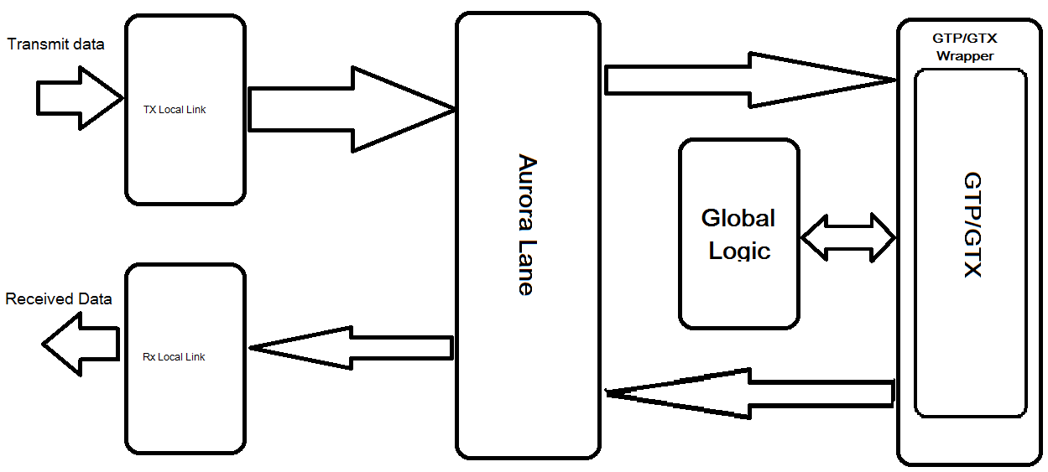
Aurora Working
TX
RX
Notes:
Lane logic: GTP/GTX transceiver driven by instance lane logic module, initializes GTP/GTX transceiver, handles the encoding and decoding
Global logic: performs the bonding and verification phases of channel initialization. the module generates the random idle characters required by the Aurora protocol, monitors all the lane logic modules for errors.
RX user interface: moves data from the channel to the application.
Streaming data is presented using a simple stream interface equipped with a data bus and a data valid signal.
Frames are presented using a standard LocalLink interface. This module also performs flow control functions.
TX user interface: moves data from the application to the channel.
A stream interface with a data valid and a ready signal is used for streaming data. A standard LocalLink interface is used for data frames. The module also performs flow control TX functions. The module has an interface for controlling clock compensation (the periodic transmission of special characters to prevent errors due to small clock frequency differences between connected Aurora 8B/10B cores). This interface is normally driven by a standard clock compensation manager module provided with the Aurora 8B/10B core, but it can be turned off, or driven by custom logic to accommodate special needs.

Slide 8
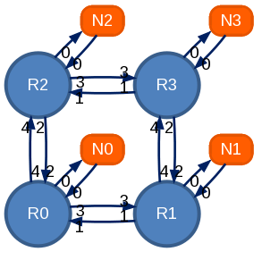
CONNECT 2X2 Mesh Network
Input / Output Flit Format (16 bit)
1 Bit Valid | 1 Bit Tail | 3 Bits Dest | 1 Bit Virtual channel | 10 bits Data
Destination | Router 0 | Router 1 | Router 2 | Router 3
0 | Port 0 (000) | Port 1 (001) | Port 2 (010) | Port 2 (010)
1 | Port 3 (011) | Port 0 (000) | Port 2 (010) | Port 2 (010)
2 | Port 4 (100) | Port 1 (001) | Port 0 (000) | Port 1 (001)
3 | Port 4 (100) | Port4 (100) | Port 3 (011) | Port 0 (000)

Slide 9
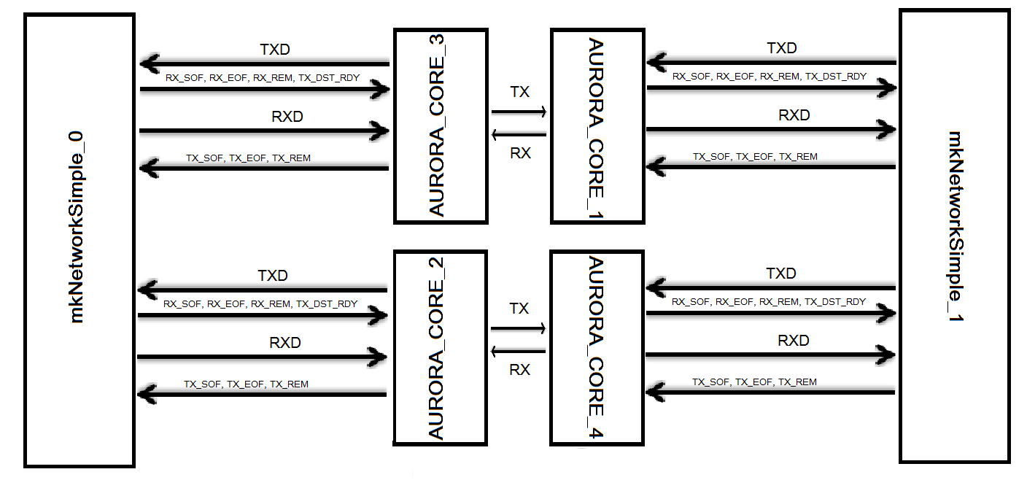
Proposed Design

Slide 10
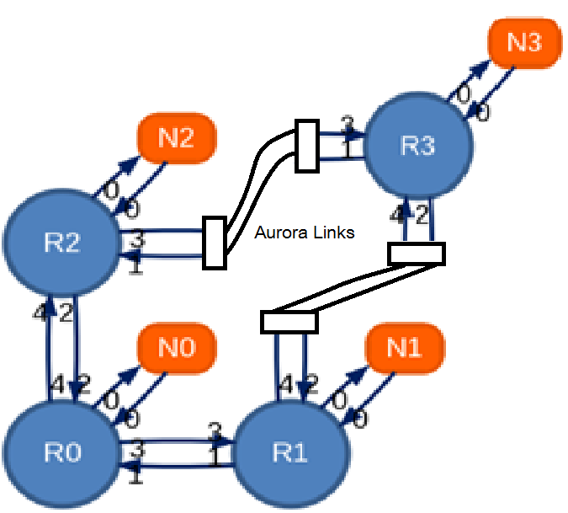
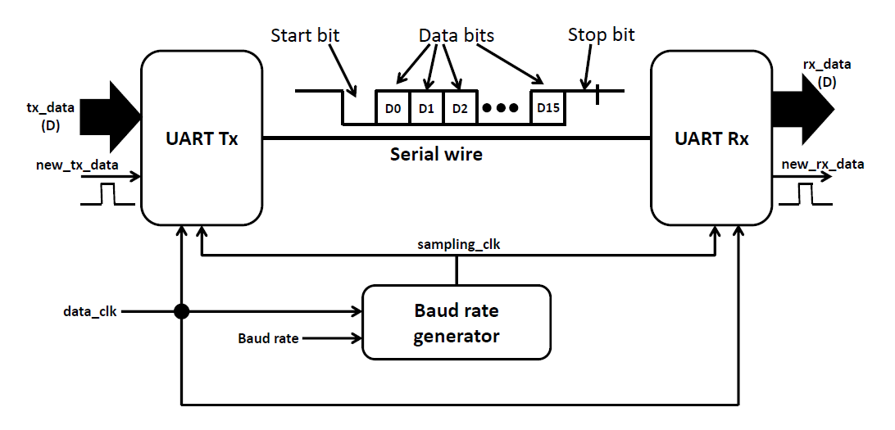
Previous Work

Slide 11
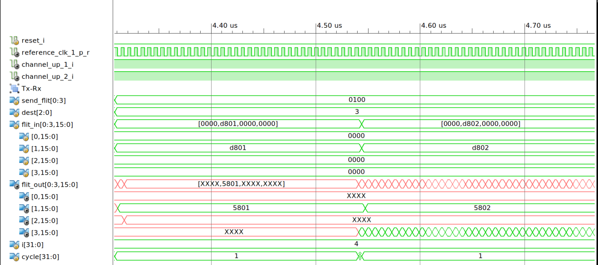
Output

Slide 12
Results
@1: Sending flit 001 into send port 0 from Router = 1 to Router = 3
@0: Receiving flit 001 at receive port of router = 3
@37: No. of cycles from source to destination
@1: Sending flit 002 into send port 0 from Router = 1 to Router = 3
@0: Receiving flit 002 at receive port of router = 3
@37: No. of cycles from source to destination
@1: Sending flit 003 into send port 0 from Router = 1 to Router = 3
@0: Receiving flit 003 at receive port of router = 3
@37: No. of cycles from source to destination
@1: Sending flit 004 into send port 0 from Router = 1 to Router = 3
@0: Receiving flit 004 at receive port of router = 3
@37: No. of cycles from source to destination

Slide 13
Conclusions
 | Un-partitioned NoC | UART Partitioned NoC | Aurora Partitioned NoC
16 Bits | 6.4 ns | 1.48 msec | 23 usec
Resource | Number Used |  | Approx. Percentage Use
 | UART | AURORA | UART | AURORA
Slice Registers | 28,794 | 29213 | 9 % | ~9%
IOBs | +18 | +16 | 1 % | ~1%
Slice LUTs | 50,482 | 50845 | 33 % | ~33 %
Block RAMs | +144 | ~ | 34 % | ~

Slide 14
Future Work
Automatic partitioning of any network
Instantiation of Aurora Links
Implementation partitioned network for applications such as Boolean Matrix Vector Multiplication (BMVM) on a Virtex V Development platform
Investigation of algorithm development for application based NoC partitioning

Slide 15
Script Parameters for NoC partitioning
#### Python script Parameters for automatic partitioning ####
import re
routers = [0, 1, 2, 3] #No. of router in partitioned network
part = [0, 1, 2] #No. of router in this partitioned network
part_no = 0 #Partition part No.
ports_per_router = 3 #No. of ports in each router
flit_data_width = 16 #Data width
vc_bits = 1
dest_bits = 2 #Destination width
data_width = 2
hex_filename = <Routing_table_<filename.hex>
#This script is supposed to partition the given network and instantiate#
#Serial Aurora module and interfaces using#

Slide 16
Thank You

